Slide 1
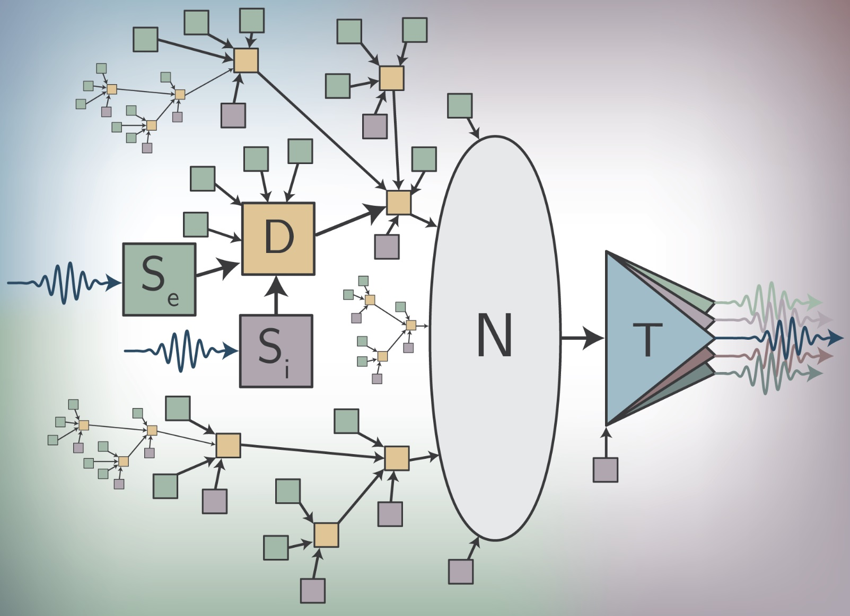
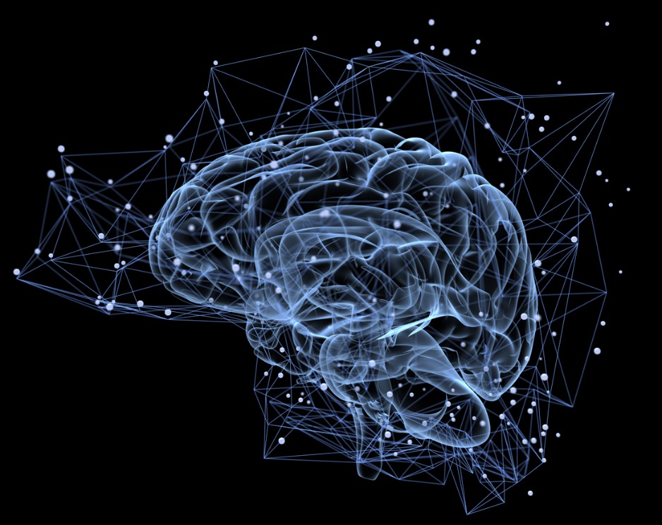
Superconductors, light, and the “age of of cognition”
“Super” Neuromorphic Computing with Photonic and Superconducting Devices
Jeff Chiles, Sonia Buckley, Adam McCaughan, Saeed Khan, Bryce Primavera,
Rich Mirin, Sae Woo Nam, Jeff Shainline
NIST, Physical Measurement Laboratory

Slide 2
High Performance Single Photon Detectors
Superconducting nanowire single photon detector
Superconducting Transistion-Edge Sensors
Microwave Kinetic Inductance Detectors
Conventional Applications
Advanced sensors for astronomy and astrophysics
High Energy Physics – rare particle event searches
Quantum Information / Quantum Computation

Slide 3

Photonic Quantum Information Requirements
 | Quantum Communication | Quantum Computing (Photonic) | Quantum Computing (atoms) | Entanglement-based random numbers
Wavelength | 1550 nm | Visible, Near-IR | UV | Near-IR
Detection Efficiency | As high as possible | As high as possible | >80% | >67%
Dark / Background counts | As low as possible
Timing jitter | As low as possible
Maximum count rate | As high as possible

Slide 4
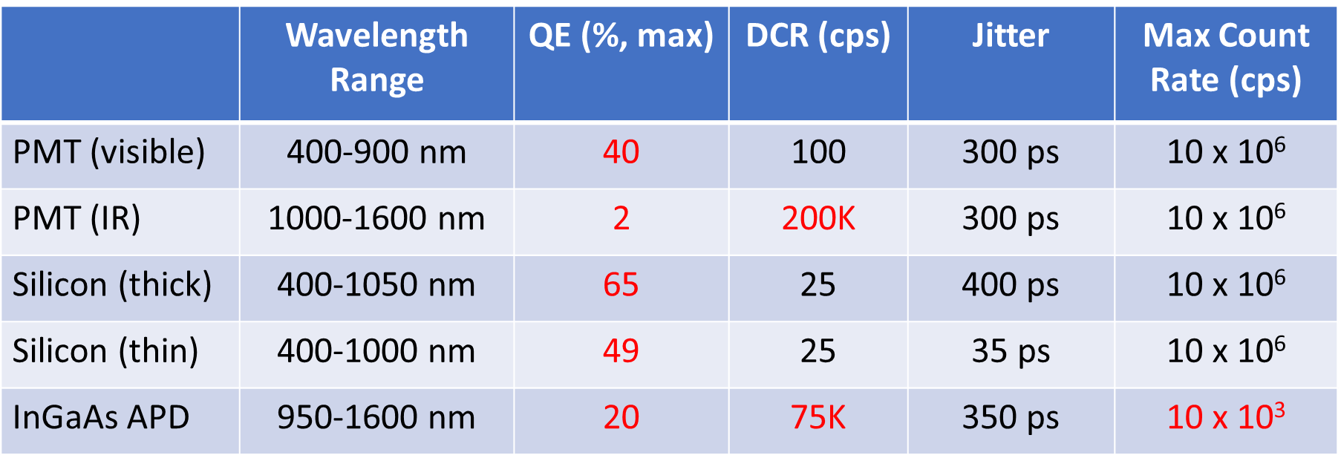
Conventional Single-Photon Detectors
Commercially available
Relatively inexpensive
M. D. Eisaman, J. Fan, A. Migdall, and S. V. Polyakov, Rev. Sci. Instrum. 82, 071101 (2011)

Slide 5
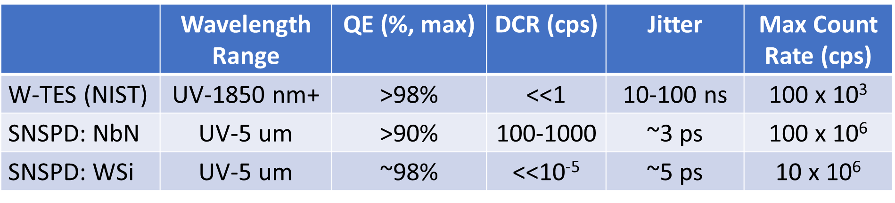
Low Temperature Physics = High Performance
TES: Transition Edge Sensor
SNSPD: Superconducting Nanowire Single Photon Detector
No afterpulsing problems
Excellent prospects for longer wavelengths

Slide 6
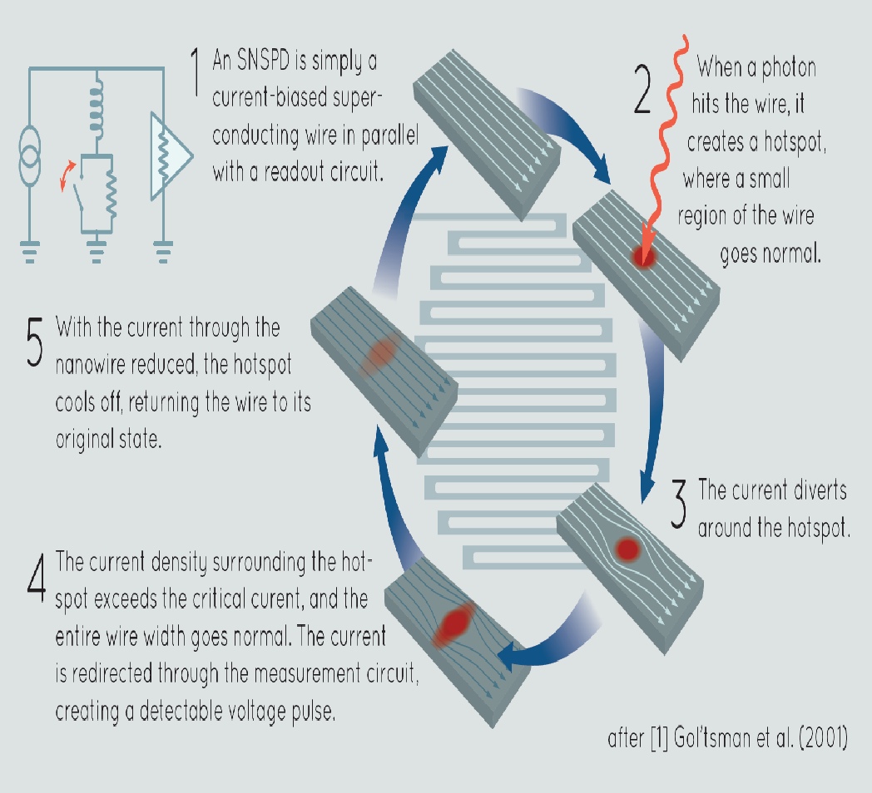
Superconducting Nanowire Single Photon Detectors:
ultra-thin (2nm to 8nm)
Anomolous kinetic inductance
NbN, NbTiN
2K operating temperature
~80nm wide
New materials:
W-Si, Mo-Si, Mo-Ge
1K operating temperature
~150nm
5 microns wide

Slide 7
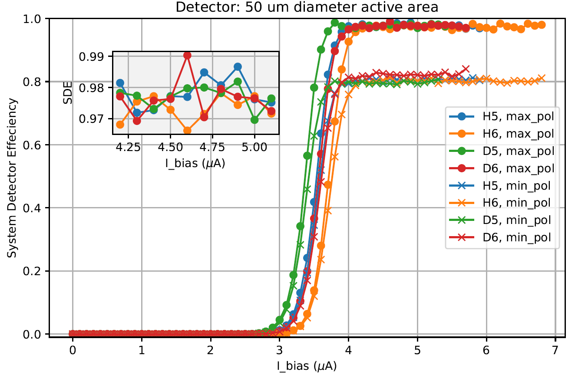
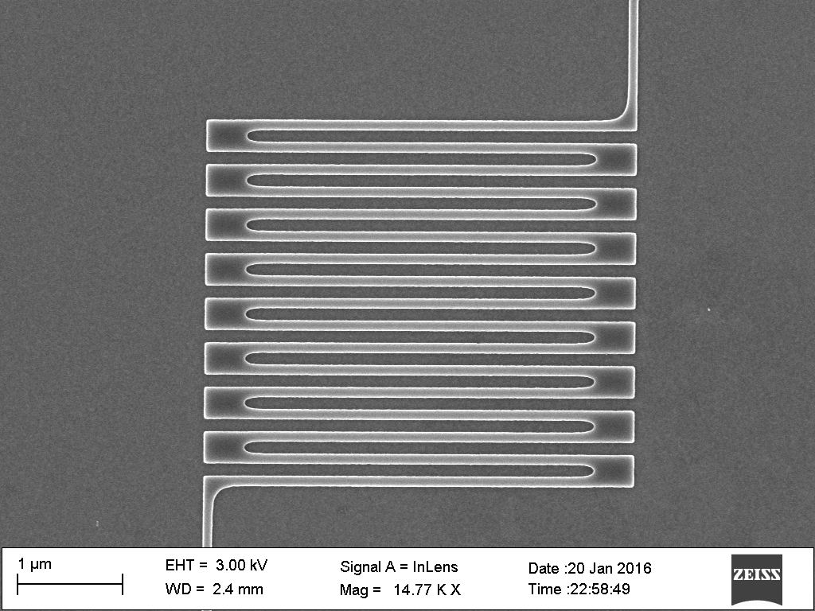
Simplicity of Superconducting Nanowire Single Photoncs Detectors
Bias versus Efficiency / counts
X
Simple Readout

Slide 8
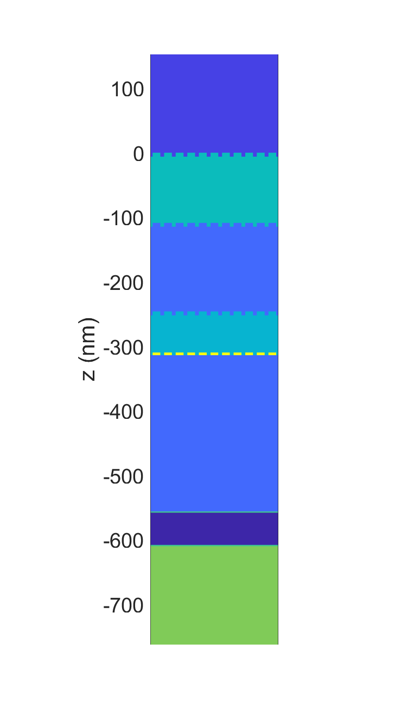
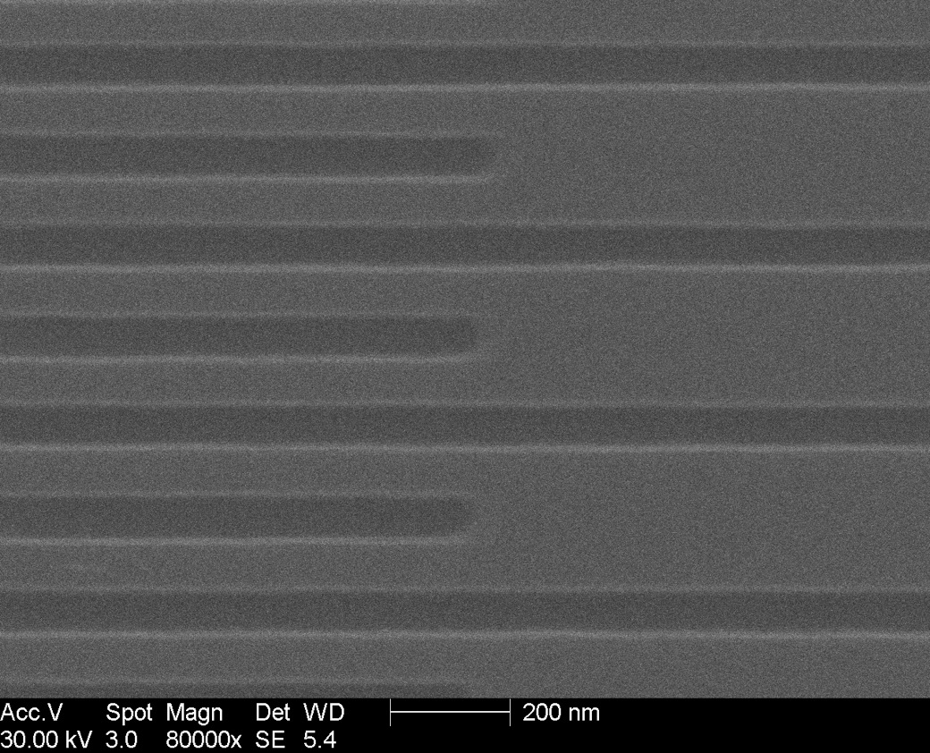
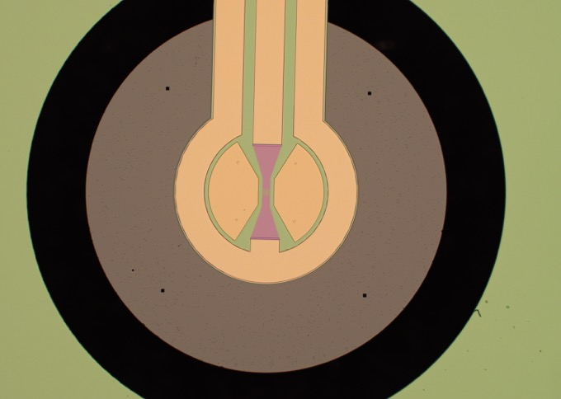
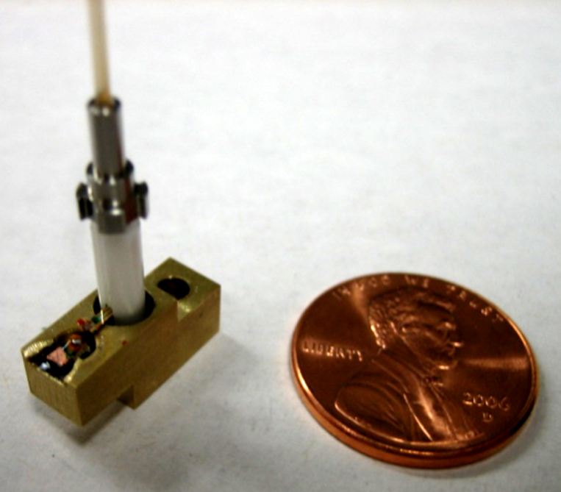
Single Pixel Devices
2.5 mm
Incoming photons
100 nm
Air
aSi
60 nm
SiO2
aSi
SiO2
Au
Substrate
Available Commercially now !!!
Notes:
8

Slide 9
Future of Computing
High Performance Computing. (HPC)
Traditional model of computation
Quantum Computing and Networking (QC)
Can outperform HPC in some tasks
Neuromorphic Computing (NC)
“Neuroscience” inspired architecture
Dedicated Hardware

Slide 10
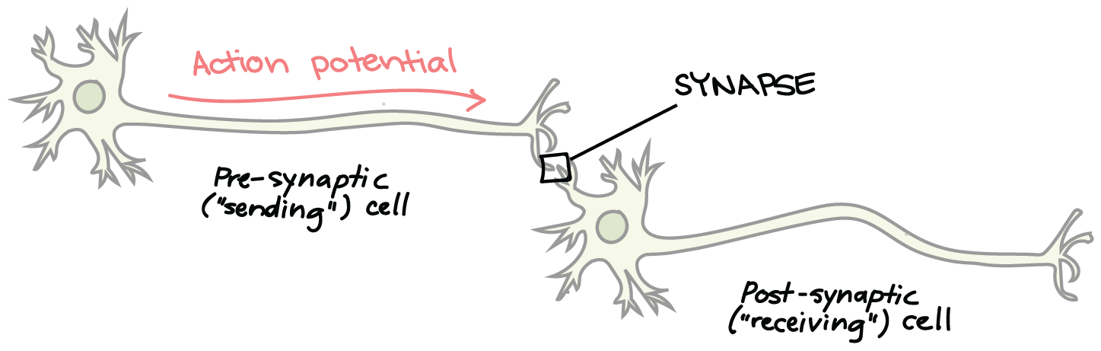
Structure of a Biological Neuron
DENDRITES
From:Wikipedia
https://www.khanacademy.org/science/biology/human-biology/neuron-nervous-system/a/the-synapse
http://spie.org/news/5681-dendritic-plateau-potentials-modulate-neuronal-function?SSO=1

Slide 11

Fast Introduction to Neural Networks
Artificial Neuron
Network of Neurons
b
w₁
x₁
inputs
w₂
Σ
x₂
F(x)
w₃
x₃
Summing
Node
Activation
Function
Synaptic
Weights
Input Cell / Layer
Hidden Cell / Layer
Output Cell / Layer
http://www.asimovinstitute.org/neural-network-zoo/

Slide 12


Supervised Learning
Untrained
Neural Network
Training
Trained
Neural Network
Inference
New
Data
not
cat
cat
✓
✓
✅

Slide 13
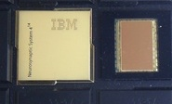

Machine learning hardware
Today, there is large demand to perform “neural network” operations
Image Classification
Speech Recognition
Natural Language Processing: “translation”
Dedicated Neuromorphic Hardware
Other Technology platforms Neuromorphic have attracted venture interest
TrueNorth, IBM
see Merolla et al.,
Science, 2011.
Bill Gates
Notes:
Plug Nick’s talk
I don’t have to make a case that Moore’s law is ending. There is a belief that electronics will not be able to supply what is needed – nothing is on the way. This was not true in 1980s. GPUs and FPGAs

Slide 14
2nd and 3rd Generation Neural Networks
2nd Generation: “Proven”
Limited Biological “inspiration”
Matrix-vector multiplication
Seeking weight matrix
Trained by supervisory system
Limited History
Task specific
3rd Generation: “Less Proven”
More Biologically inspired
Information in dynamical state
Spiking neurons communicate in rate and timing
Potential for learning without supervision
Information integrated across space and time
General cognitive systems

Slide 15
Question: Why do we need Generation 3? Answer: Energy Efficiency and Size
“How do you make the largest scale artificial neural network?”
Human Brain:
10 billion neurons
1 neuron fans out to 10,000 neurons
What are the fundamental limits?
How do you evaluate the performance?
How do physical characteristics of the devices relate to the performance of the neuromorphic computer?
https://arxiv.org/abs/1906.02243v1

Slide 16
Spiking Neural Networks / Dedicated Hardware
Biologically Inspired
Spiking Signals, Energy Efficient
Rate and Time encoding
Differentiated local processing
Information integration across:
Space (network structure)
Time (dynamics)
Experience (plasticity)
Can we get to a size scale for “Cognitive” Systems?

Slide 17
Energy and Training Targets
Power
2500 kCal/day = 100Watts
Clock speed
1 Hz to 1kHz
Training time
18 years
Human
Power
100 kW to 1 MW
Clock speed
1 Mhz to 10MHz
Training time
1 week
Artificial
Notes:
Dominated by light source
1fJ is needed per synapse
10^10 neurons * 10^4 connections * 1fJ / 10^-4 efficiency of the source = 10^3 Joules
10^6 clockspeed * 10^-3 utilization (not all neurons firing at once) = 1Mwatt

Slide 18
Energy estimates
10^10 neurons
10^10 * 10^4 connections
10^10 * 10^4 * 10^5 photons
10^19 photons * 10^4 inefficiency
10^23 photons = 10^23 eV = 10^4 J
1fJ = 1e-15J = 10 photons

Slide 19
Fluxonic processing of photonic synapse events
Spiking neural networks
jeffrey.shainline@nist.gov

Slide 20
Fluxonic processing of photonic synapse events
Light for communication

Slide 21
Fluxonic processing of photonic synapse events
Superconducting electronics for single-photon detection

Slide 22
Fluxonic processing of photonic synapse events
Superconducting electronics for neural computation

Slide 23
Fluxonic processing of photonic synapse events
Neuromorphic supercomputing

Slide 24
Device requirements for massive connectivity
Dense local fanout
Long-range connectivity
We seek very large systems
Energy efficiency is paramount
Principal conjecture:
Use light for communication
Photons don’t have charge or mass
Use single-photons for communication

Slide 25
Neurons that signal with single photons

Slide 26
Neurons that signal with single photons
How do they work?

Slide 27

Superconducting loop

Slide 28
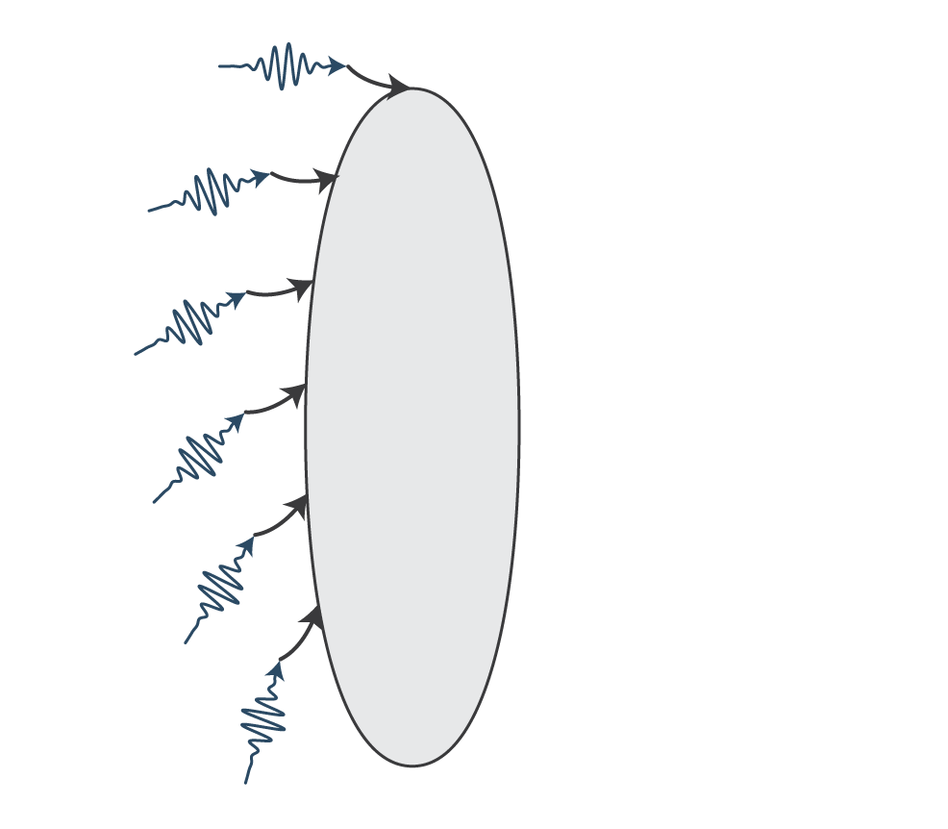
Photons add current

Slide 29
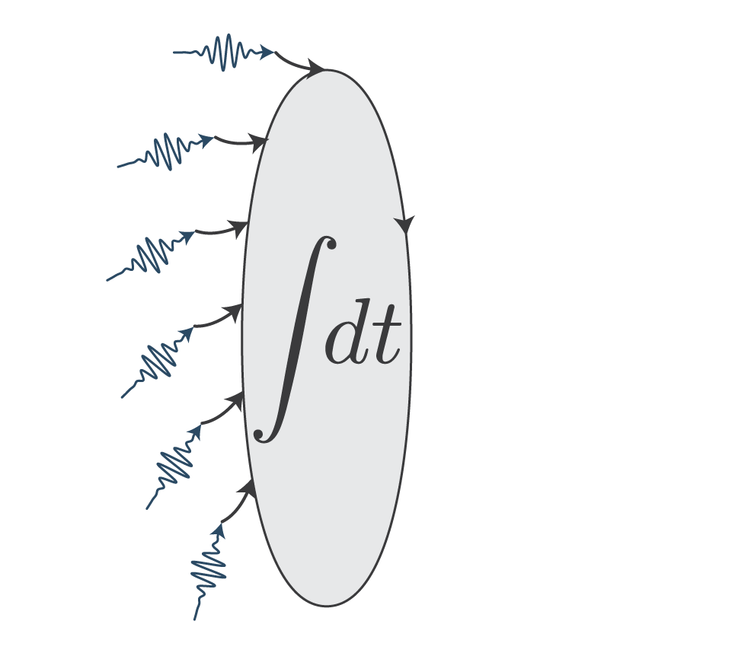
Current gets integrated

Slide 30
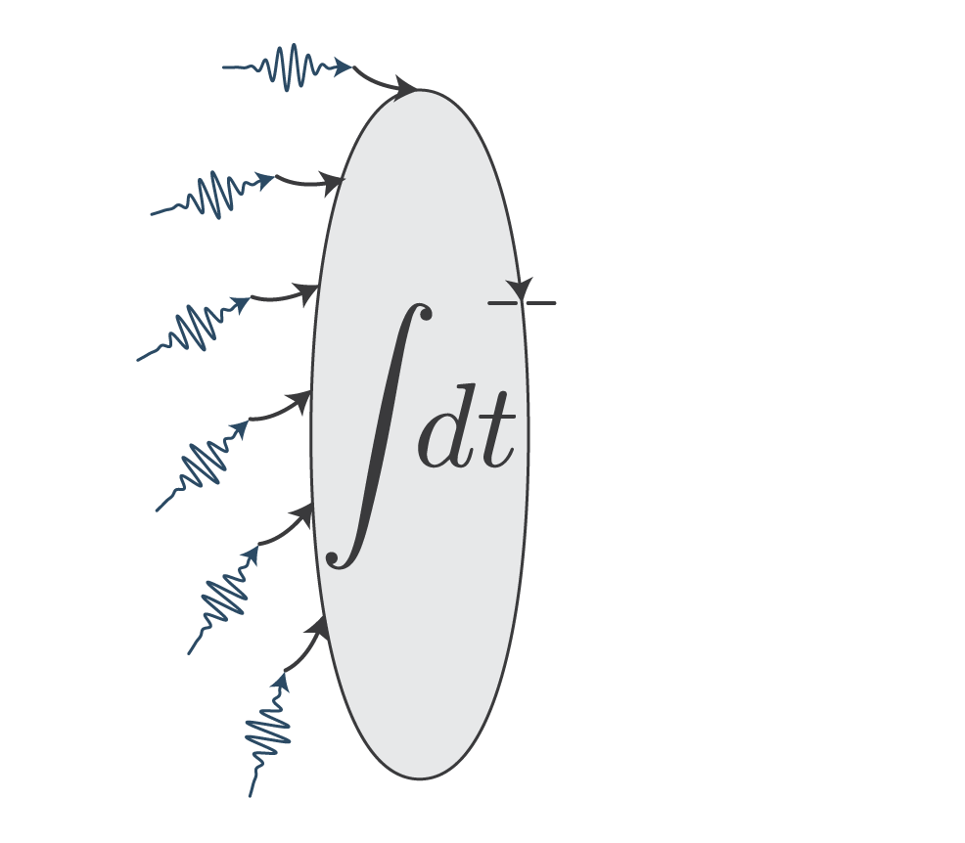
Current threshold

Slide 31

Current threshold

Slide 32
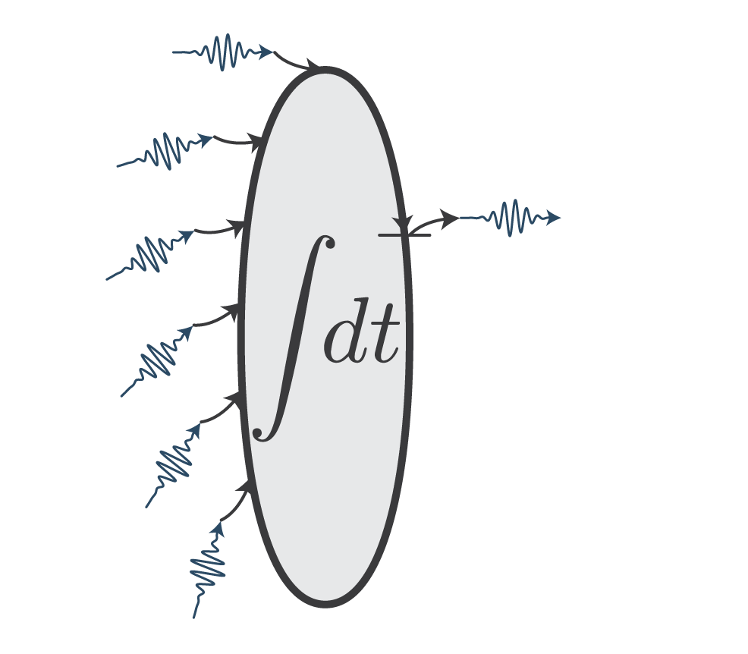
Photons produced

Slide 33
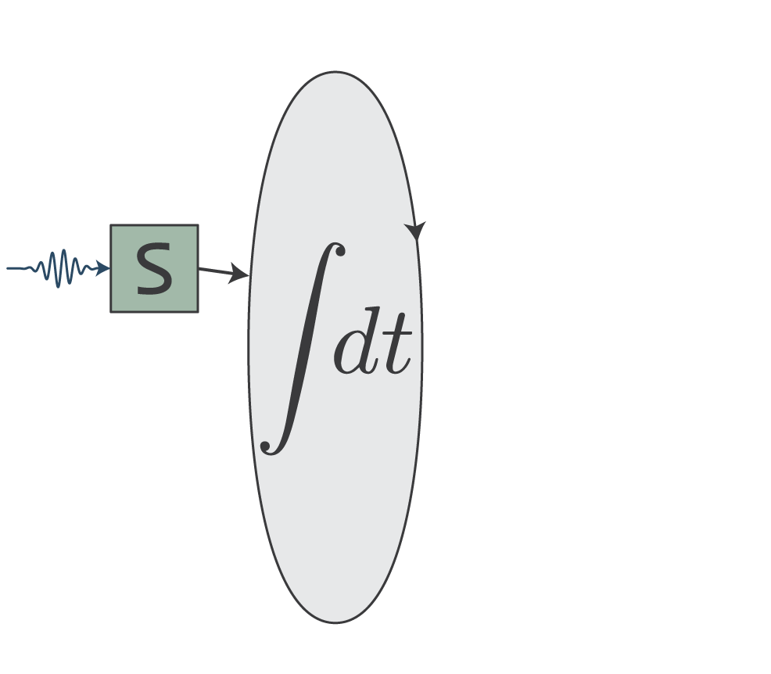
Synapse transduces

Slide 34
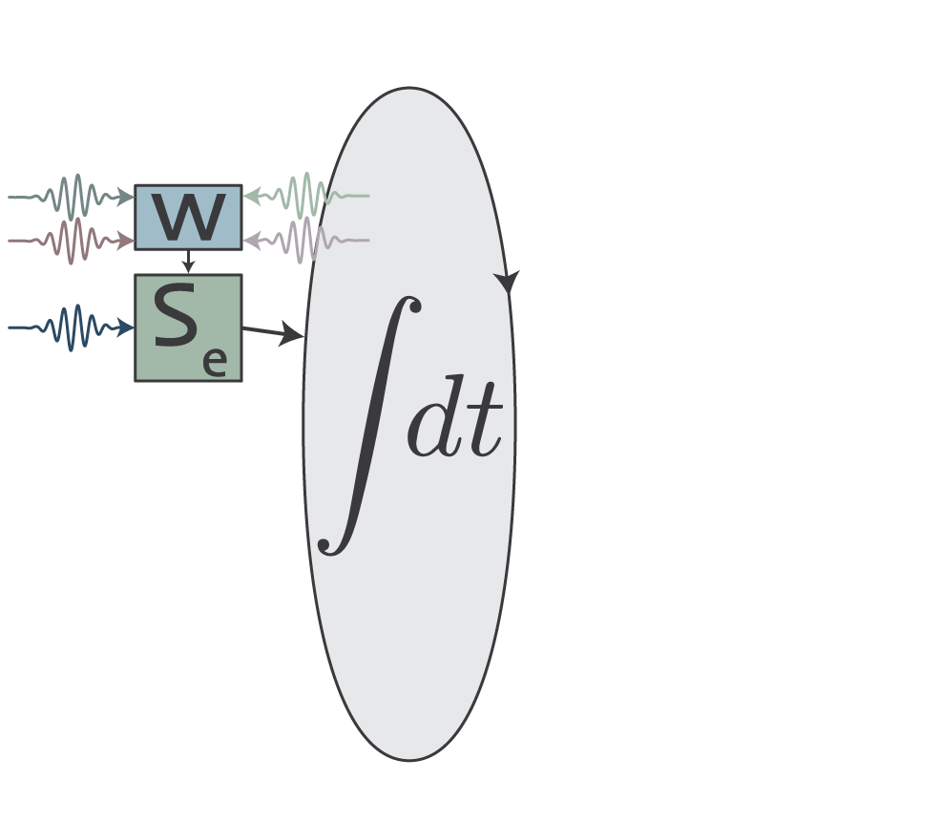
Photons update weight

Slide 35
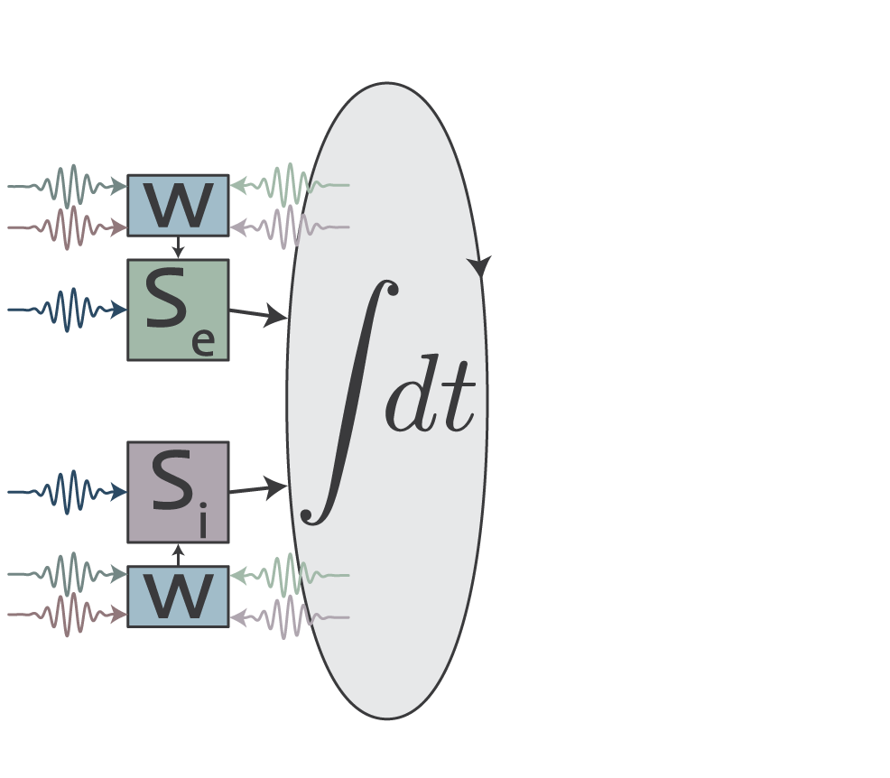
Inhibitory synapses

Slide 36
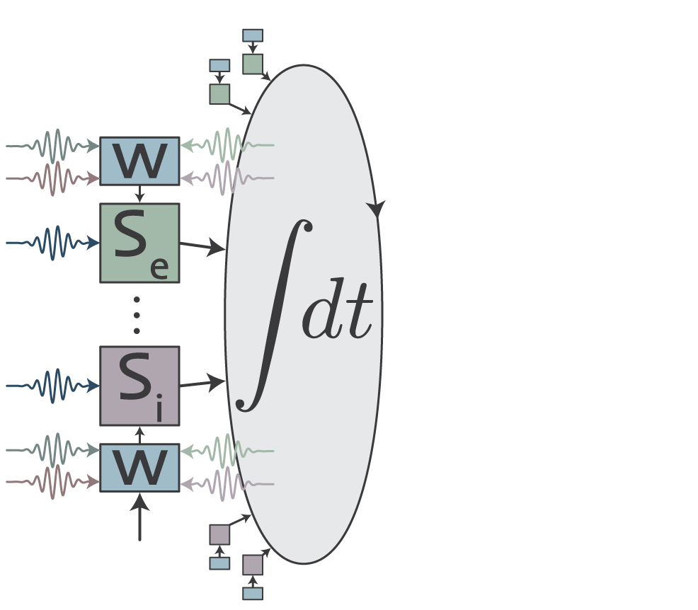
Many synapses

Slide 37
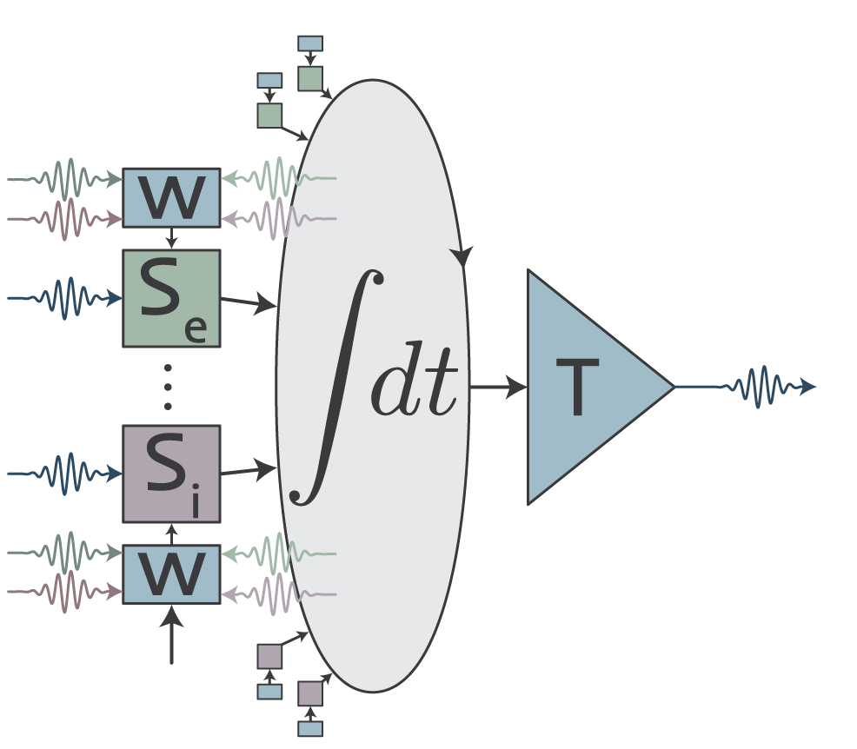
Transmitter circuits

Slide 38
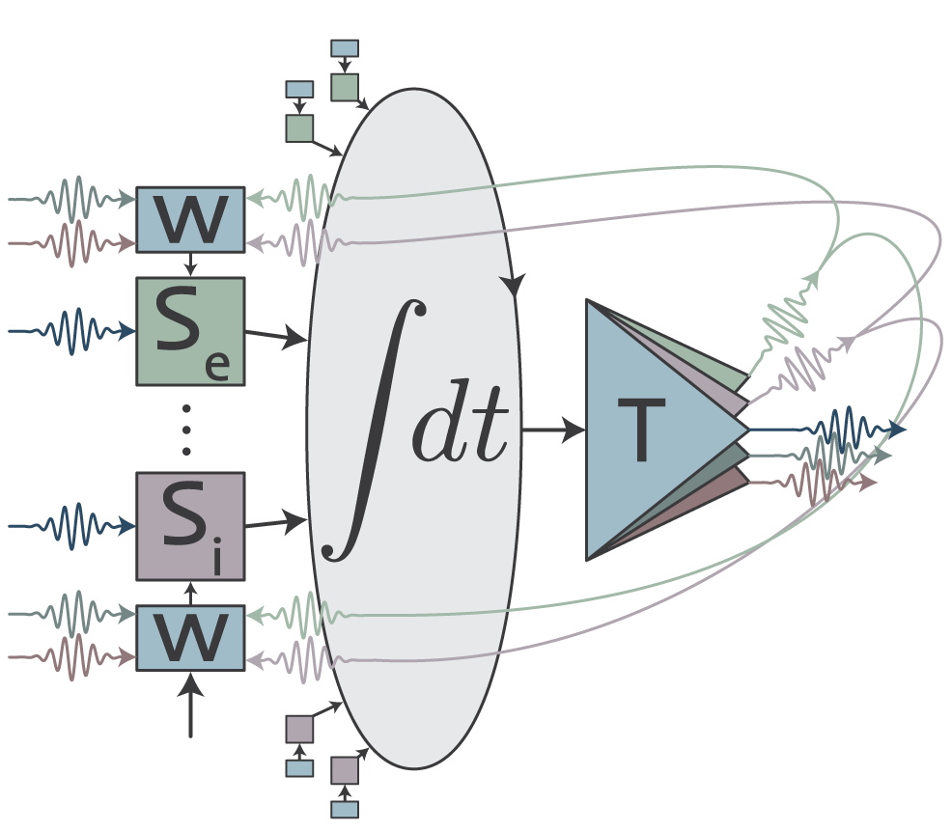
Colors for different operations

Slide 39


Slide 40


Slide 41
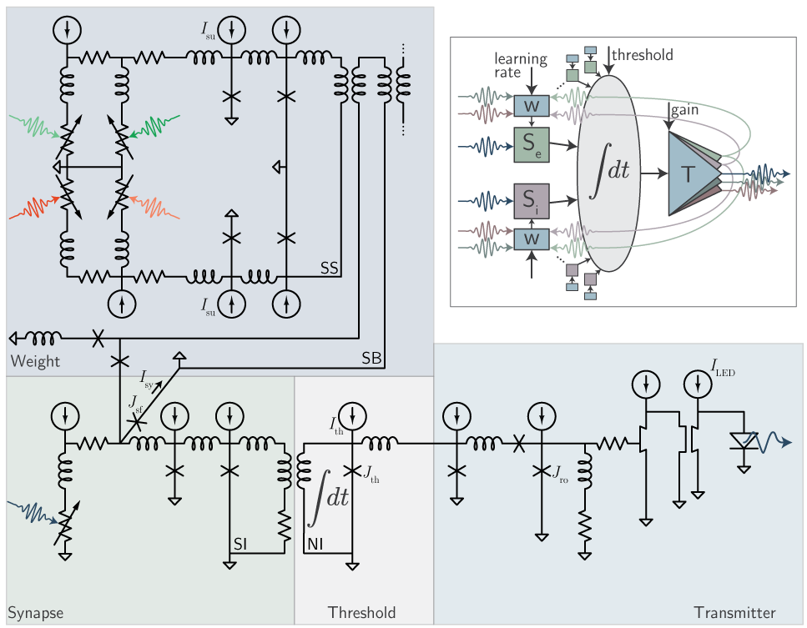
Loop neuron
Shainline et al., arXiv:1805.01929 (2018).
Shaineline, arXiv:1904.02807 (2019)

Slide 42
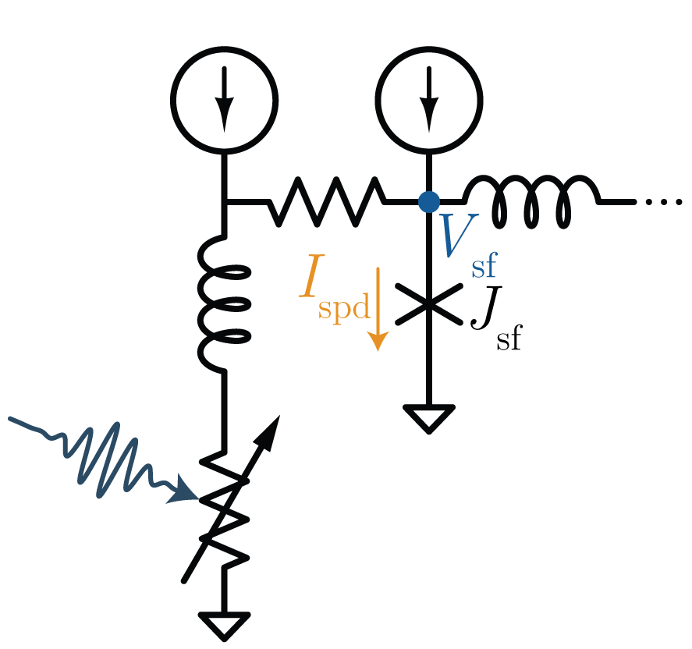
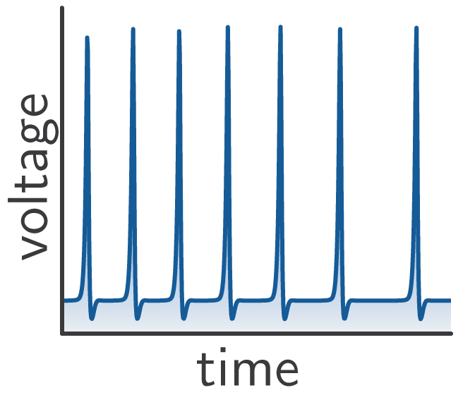
Photon-to-fluxon transducer
these are fluxons

Slide 43
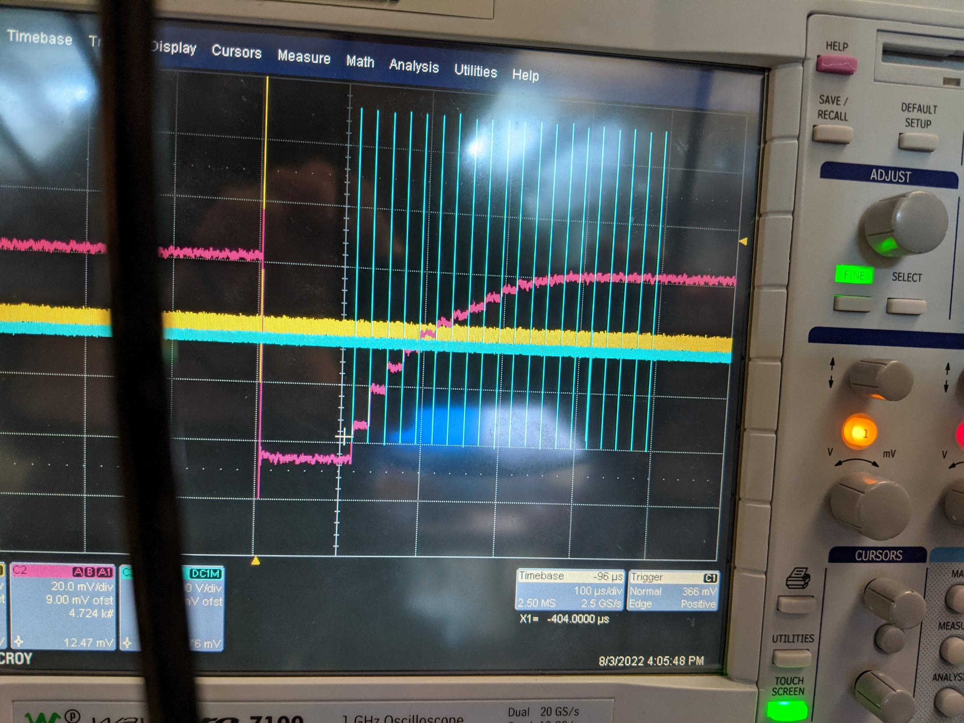
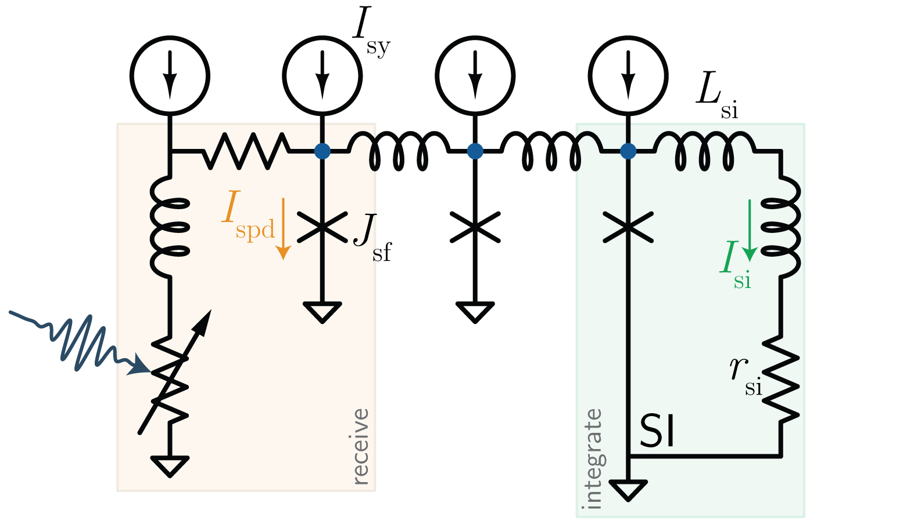
The synapse

Slide 44
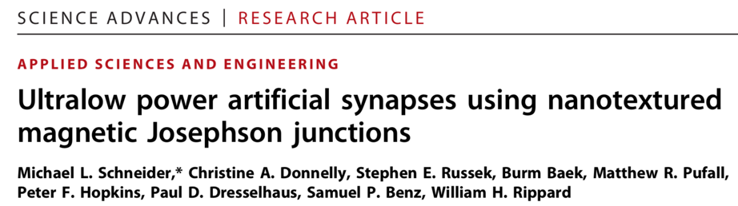
Long-range = photons
Short-range = electronics / SFQ
Pulsed neural networks consisting of single-flux-quantum spiking neurons
T. Hirose, T. Asai, and Y. Amemiya
Physica C, 463:1072, 2007.
https://arxiv.org/abs/1907.00263
A Power Efficient Artificial Neuron Using Superconducting Nanowires
Emily Toomey, Ken Segall, Karl Berggren

Slide 45
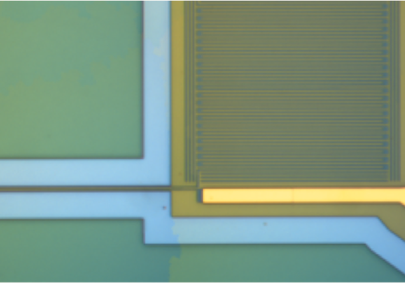
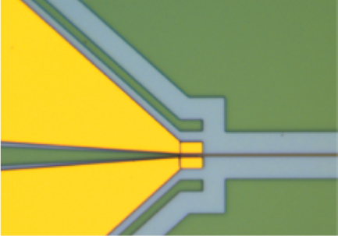
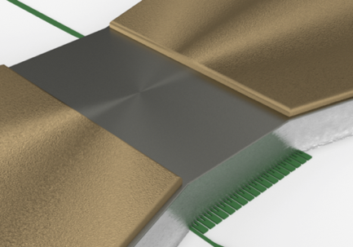
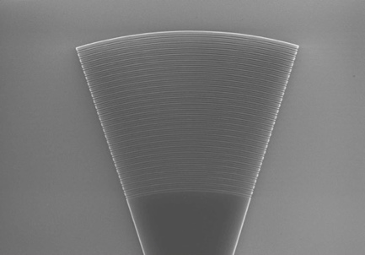
SOEN technical approach superconducting optoelectronic networks
1.
Single photons for minimum spike energy
(superconducting single-photon detectors )
2. Cold optoelectronics for monolithic integration
(all-silicon light-emitting diodes)
3. Cold electronics (SFQ) for nonlinear processing
(Josephson junctions, cryotron switches)
4. Light for interconnects
(silicon photonics)
2.
3.
4.
J. M. Shainline, S. M. Buckley, R. P. Mirin, and S. W. Nam, “Superconducting optoelectronic circuits for neuromorphic computing,” Phys. Rev. Applied, Mar 2017.
Notes:
Accepting to work at cryogenic temperatures means other devices become available

Slide 46
cryogenic silicon photonics platform: recent results

Slide 47
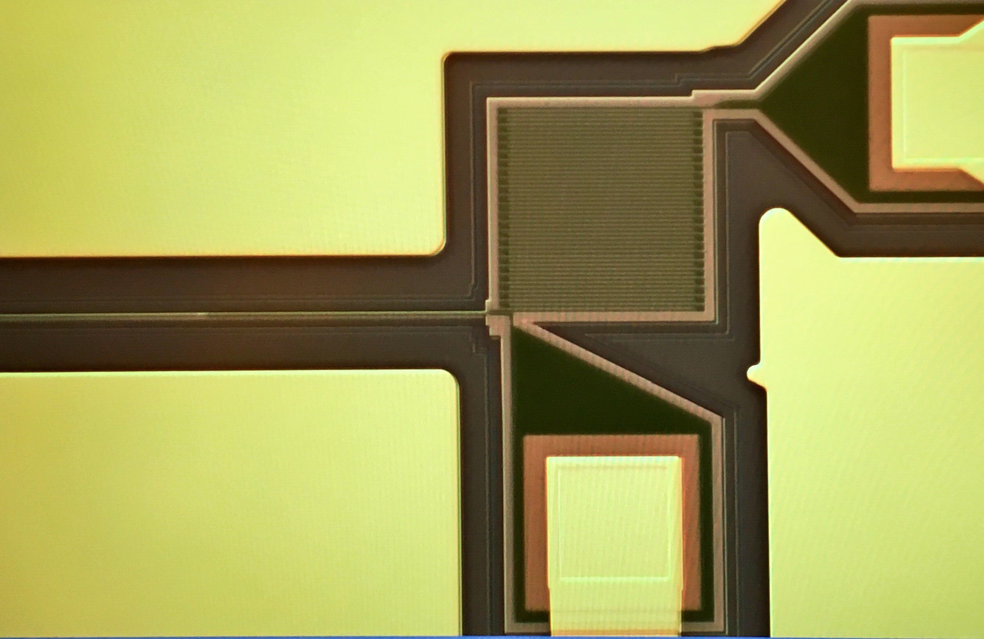
Superconducting Nanowire Detector
single photon
5 nm
160 nm
Nanowire on waveguide
Waveguide

Slide 48
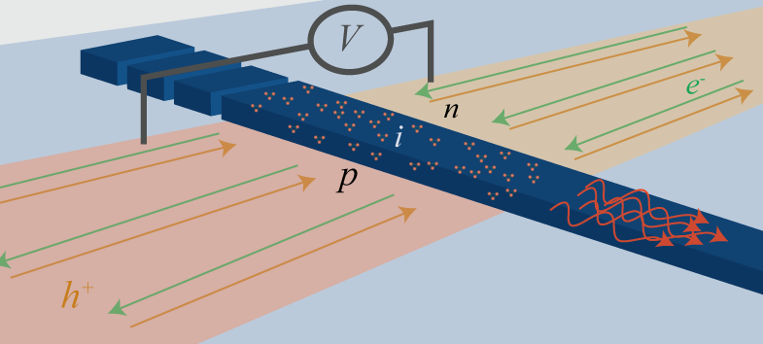
All-silicon light emitting diodes
Si defect centers have optical transitions
Low temp. inhibits non-radiative pathways
Electrical pumping with PN junction
W-centers: 1220nm emission
S. M. Buckley et al. “All-silicon light-emitting diodes waveguide-integrated...” APL, 2017.
Notes:
Describe the fabrication briefly

Slide 49
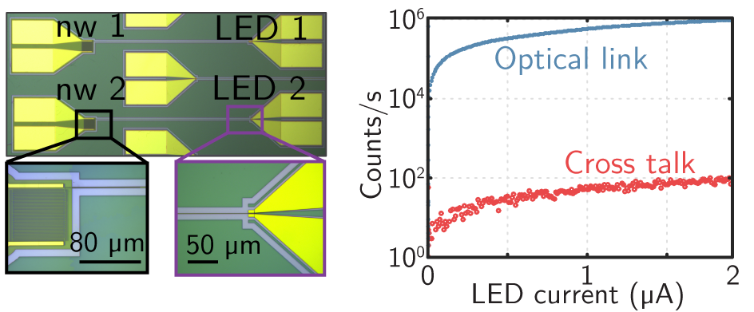
Co-integration: Silicon LEDs + SNSPDs
S. M. Buckley et al. “All-silicon light-emitting diodes waveguide-integrated...” APL, 2017.
Notes:
Say that: since this article, we have enhanced photoluminescence by a factor of 300. Promising results and a paper is in preparation.

Slide 50
All-silicon light emitting diodes
LED turn-on voltage is ~ 1 V
SNSPD can output ~ 1 mV
S. M. Buckley et al. “All-silicon light-emitting diodes waveguide-integrated...” APL, 2017.
Notes:
Describe the fabrication briefly

Slide 51
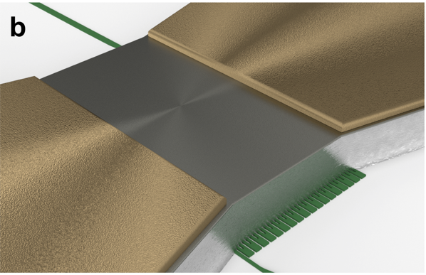
Nano-cryotron thermal switch
millivolt input -> Volt output
No Josephson Junctions needed
Reset about 10ns
A. McCaughan et al. “A compact, ultrahigh impedance superconducting thermal switch for interfacing superconductors with semiconductors and optoelectronics,” arXiv:1903.10461, 2019.

Slide 52
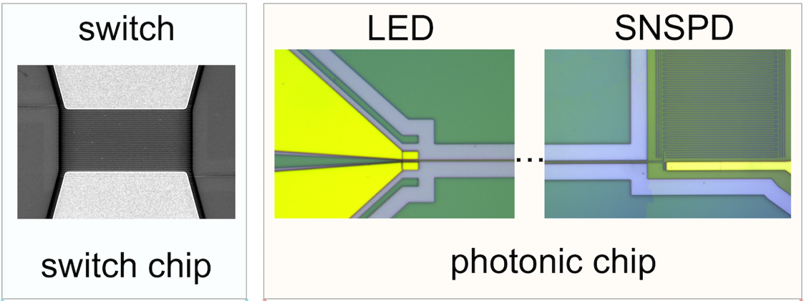
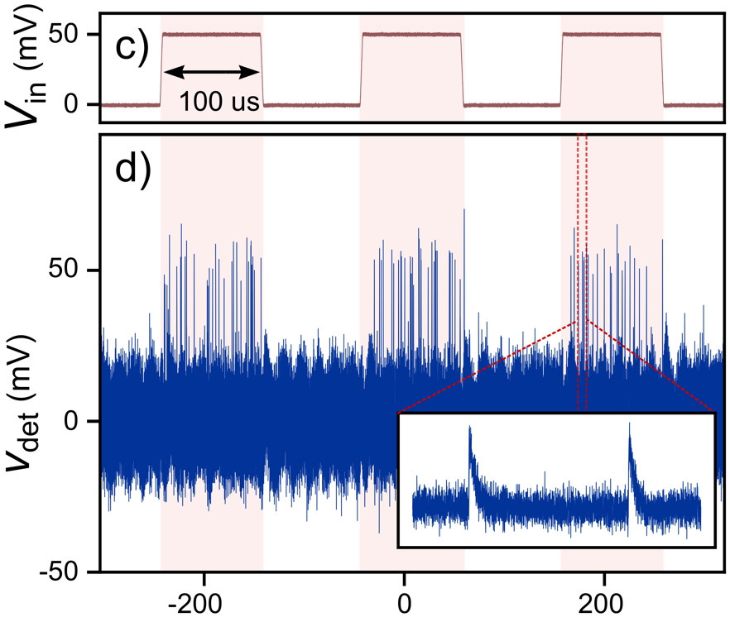
Superconductor-to-semiconductor interface
4.6 us
Time (us)
A. McCaughan et al. “A compact, ultrahigh impedance superconducting thermal switch for interfacing superconductors with semiconductors and optoelectronics,” arXiv:1903.10461, 2019.
Notes:
What points to make about this

Slide 53
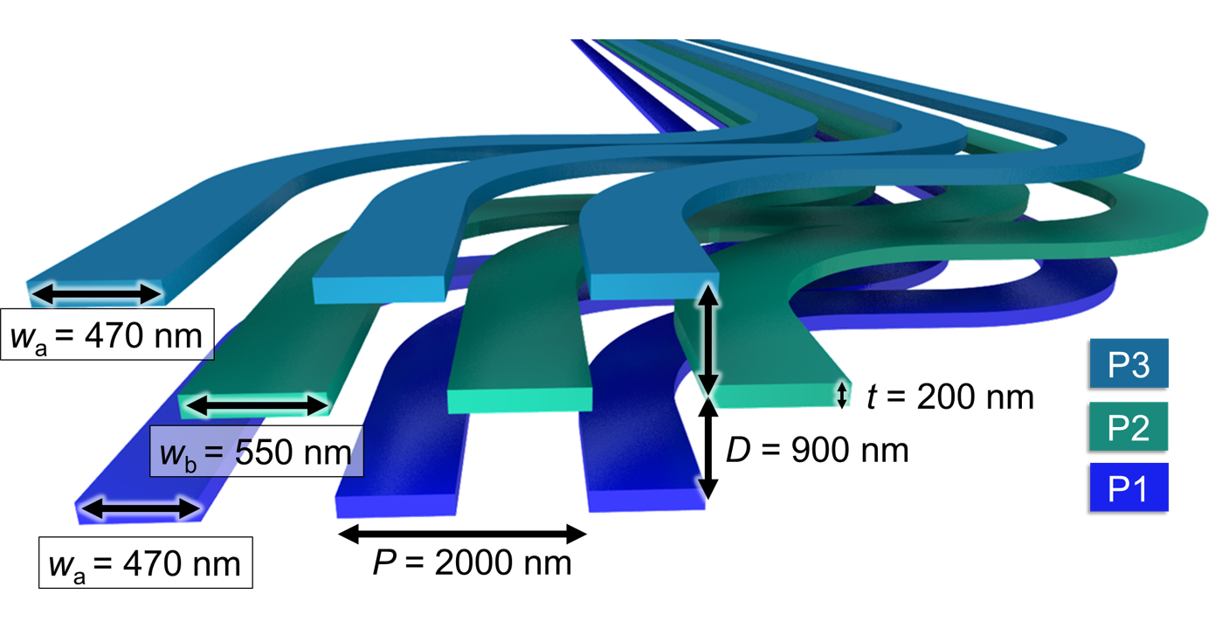
First steps toward photonic networks
Three planes of amorphous silicon waveguides
Chiles et al., APL Photonics 2, 116101 (2017)

Slide 54
Inter-planar couplers
0.05 dB loss
36 μm length
36 μm
Chiles et al, APL Photonics 2 116101 (2017).

Slide 55
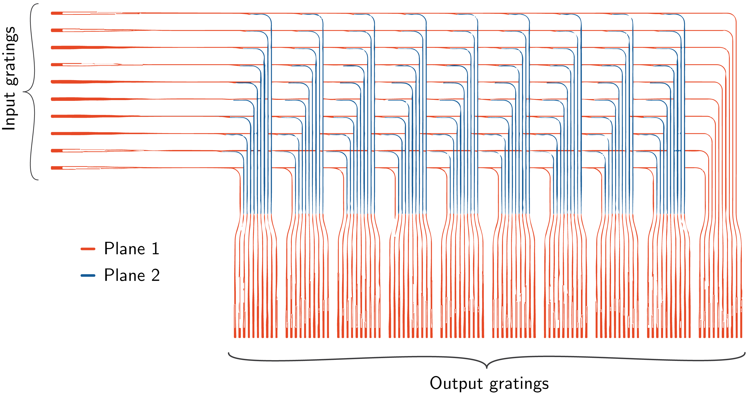
10 x 100 routing couplers
Chiles et al, APL Photonics 3 106101 (2018).

Slide 56
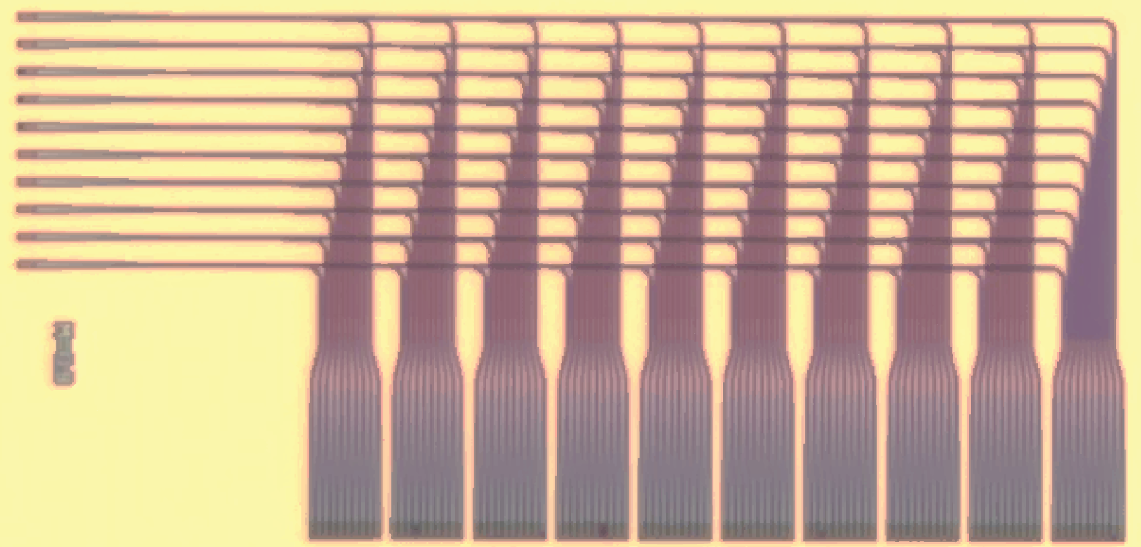

10 x 100 routing couplers

Slide 57
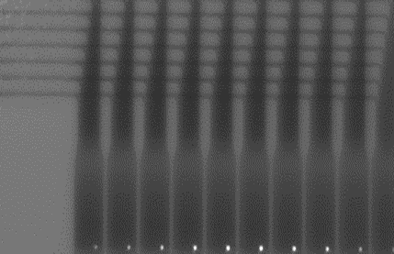

10 x 100 routing couplers

Slide 58
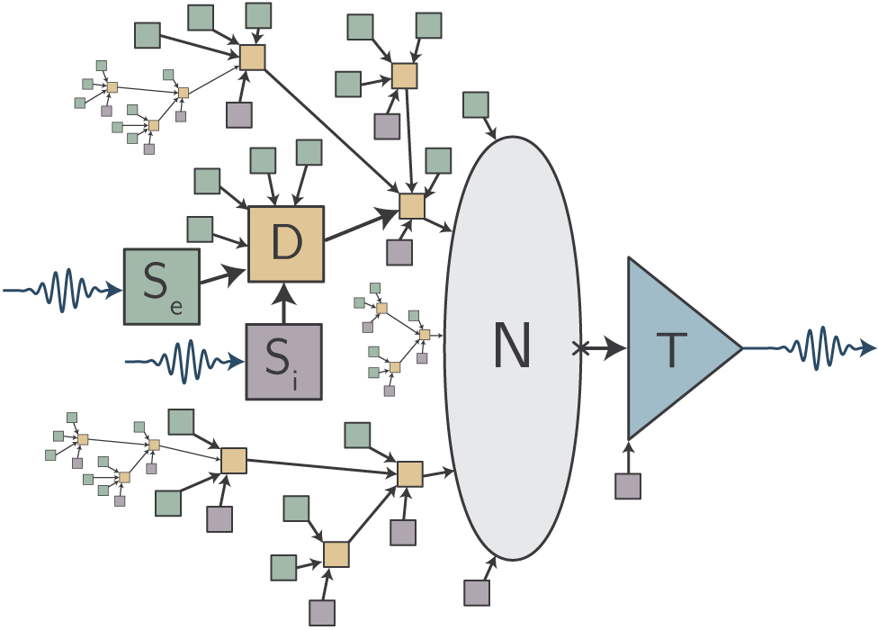
Full Superconducting Optoelectronic Neuron
Josephson
Junction circuits
Superconducting
Switch
SNSPDs
Silicon LED
Optical
Electronic
Electronic
Optical
Fluxonic
J. M. Shainline, “Fluxonic processing of photonic synapse events,” arXiv:1904.02807, 2019.
Notes:
photons are expensive
one circuit multiple purposes (enumerate some)
summing and intermediate processing
Come back to characteristic length. We should pack a bunch of complexity in a small space and make it electronic

Slide 59
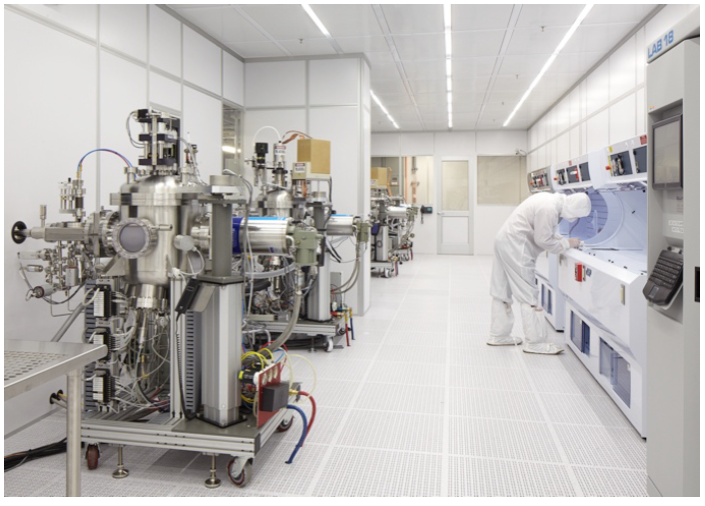
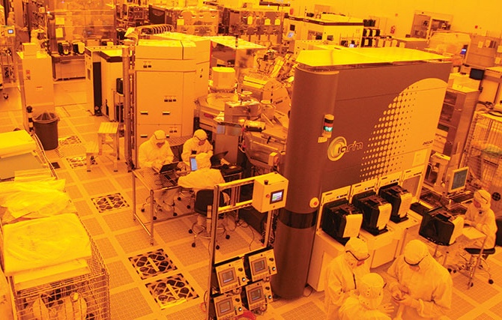
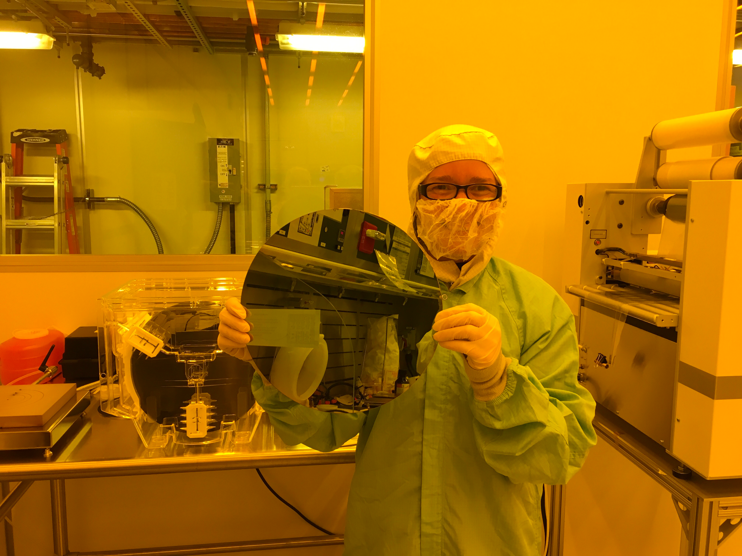
Eventual transfer to 300 mm foundry
Notes:
And for better scale

Slide 60
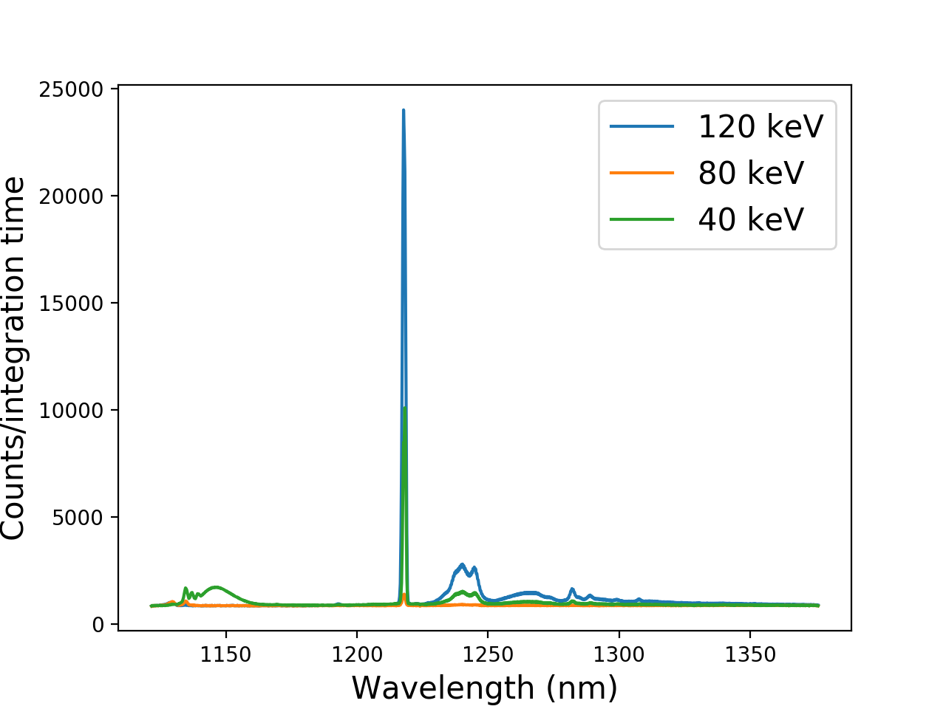
Light sources on 300-mm wafers
Photoluminescence of W centers in Si at 4 K
Fabricated at SUNY Poly by Pops Papa Rao and team
Measured at NIST by our team

Slide 61
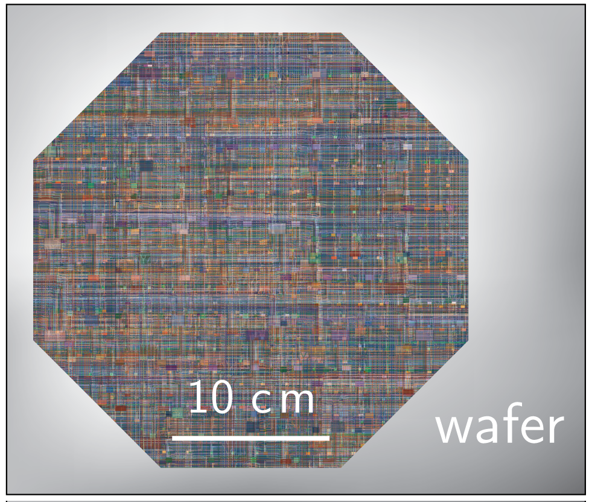
Wafer-scale modules

Slide 62
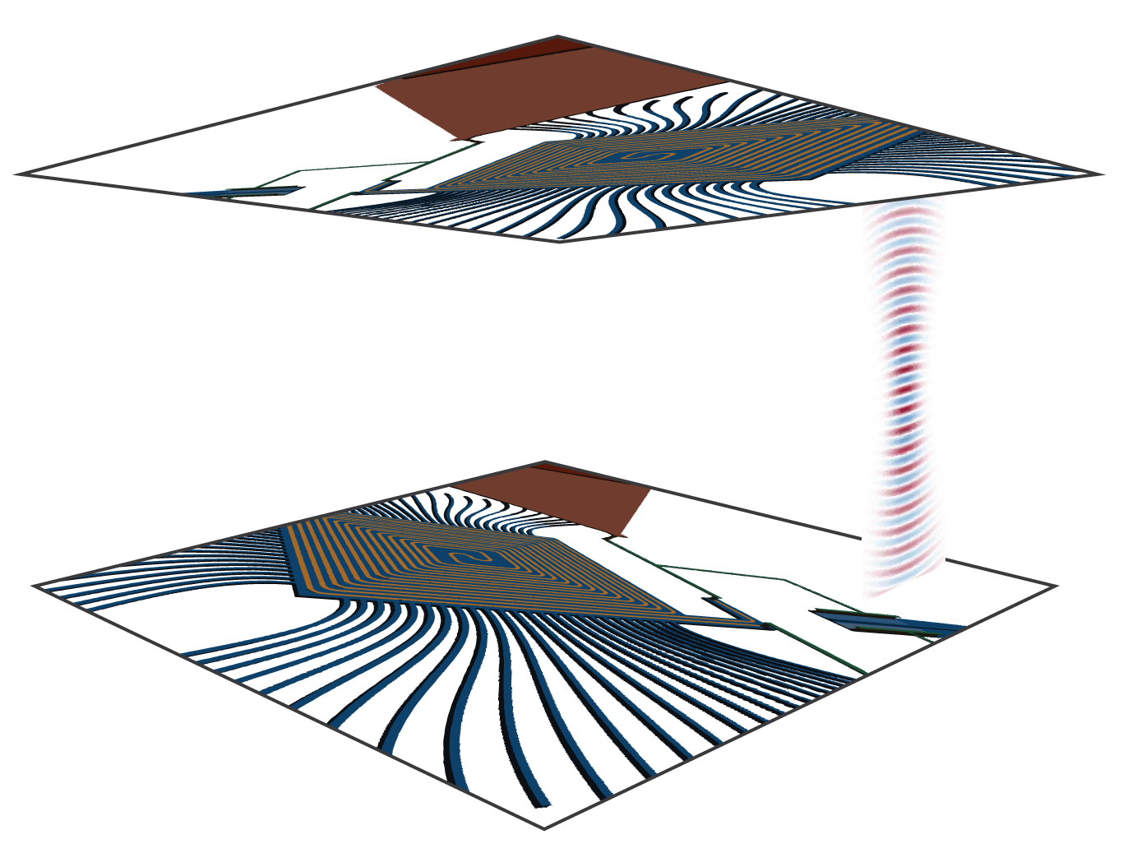
Free-space interconnects for 3D

Slide 63

Free-space inter-wafer interconnects

Slide 64

Multi-wafer modules

Slide 65

Brain-scale systems?
> 100 Billion neurons

Slide 66


What can we do in five years?
Artificial visual cortex

Slide 67
Superconducting
optoelectronic
networks
Dense local fan-out with photonics
Long-range communication at light speed
Computing and memory with superconducting electronics
Would this reach the limits of cognition?

Slide 69
Summary
Low Temperature Devices have the potential to be important in super-neuromorphic computing
Light for communication
Superconductors for computation
Complex neuro circuits
Can we get to a size scale for “Cognitive” Systems?

Slide 70

NIST team
Rich Mirin
Jeff Shainline
Sonia Buckley
Adam McCaughan
Alex Tait
Jeff Chiles
Saeed Khan
Krister Shalm
Marty Stevens
Adriana Lita
Varun Verma
Nima Nader
Mike Mazurek
Dileep Reddy
Eric Stanton
Galen Moody
Kevin Silverman
Thomas Gerrits
saewoo.nam@nist.gov
MIT, JPL, Suny-Poly
Boulder Labs

Slide 71

Cryogenic sensors

Slide 72

Collider readout

Slide 73

Genetic analysis

Slide 74

Neuroscience

Slide 75

Traffic networks

Slide 76

Data centers

Slide 77

Quantum interface

Slide 78


Quantum-neural hybrid systems
Quantum systems:
Inherently probabilistic
Quantum computing statistical
Entanglement fragile
Difficult to scale
Neural systems:
Sample probability distributions
Perform Bayesian inference
Spiking information robust
Highly scalable
What can a neural system know about a quantum system?

Slide 79

Structure of a Biological Neuron
From:Wikipedia
http://spie.org/news/5681-dendritic-plateau-potentials-modulate-neuronal-function?SSO=1

Slide 80


Process development
NIST cleanroom for near-term results
3”

Slide 81

Process development
NIST cleanroom for near-term results
SUNY Poly for development of optoelectronic process at 300 mm scale

Slide 82

Very large cognitive systems
10¹⁰ times the number of synapses as the brain
Operating 30,000 times faster

Slide 83

Superconducting optoelectronic networks
Light for communication
Superconductors for computation
Complex neuro circuits
arXiv:1805.01929
arXiv:1805.01947
jeffrey.shainline@nist.gov

Slide 84

Quantum-neural hybrid computing

